Slide 1

School Budgets SY 2026- 2027
March 2026

Slide 2
Table of Contents
1
Review the NYCPS’ & Your District’s Budget
2
Review Fair Student Funding
3
Review School Budget Webpages

Slide 3
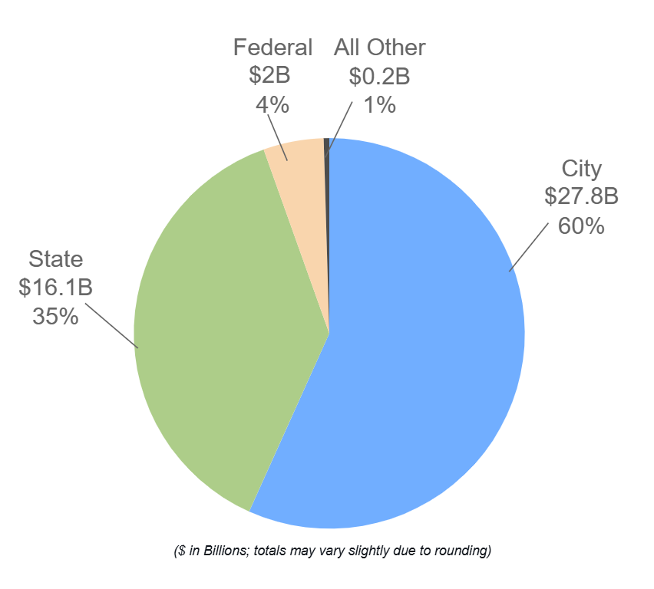
Where Does Our Funding Come From?
$46.1 billion $34,717 per student

Slide 4
How is the $46.1B NYC Public Schools Budget Spent?
The $46.1 NYCPS budget is distributed by the city, in the financial plan, within designated spending buckets.
The below figures show how the city has allocated funds to NYCPS in FY 2027.
The FY 2027 budget according to FY27 January Plan highlights how Schools and their Administration will schedule their budgets.
This FY27 January Plan report details how the $20.3 billon in City Funds for Early Childhood and K-12 Instruction are planning on being spent for the 2026-2027 school year.
$19.8B
$26.3B
$19.8B, or 43% of the budget is Non-Discretionary
$26.3B, or 57% of the budget is Discretionary with $20.3B or 44% in direct supports to schools & students
Area | Amount | %
Employee Benefits | $9.0B | 19%
Debt Services | $4.1B | 9%
Charter Schools | $3.7B | 8%
Non-Public & Contract Schools | $3.0B | 7%
Total | $19.8B | 43%
Area | Amount | %
K-12 Schools | $17.5B | 38%
Early Childhood | $2.8B | 6%
School Operations | $5.5B | 12%
Field Admin Offices | $0.4B | 0.8%
Central Admin | $0.1B | <1%
Total | $26.3B | 57%

Slide 5
District 28 2025-2026 School Budgets
$702 million
As of the FY 2026 adopted budget.

Slide 6


Who decides how money is spent at the school level?
Principals together with the School Leadership Team (SLT) decide how the school will use their money.
School Leadership Team (SLT)
Work collaboratively with the Principal to create or update the school’s Comprehensive Educational Plan (CEP) based on school specific instructional needs and priorities.
Superintendents
Underscore the Chancellor's goals and responsible for ensuring resources are aligned to the school's CEP.
Field Teams
Budget Directors and Human Resource Directors provide guidance and ensure adherence to policies.

Slide 7
Fair Student Funding (FSF)
What is FSF?
How does FSF work?
Proposed weights for SY 2026-2027

Slide 8

What is Fair Student Funding?
Fair Student Funding (FSF) is the largest funding stream provided making up about two-thirds of NYCPS K-12 budgets.
The formula is based on the number of students enrolled at each school + the specific needs of those students.
Student needs are “weighted” based on the cost of meeting a student's educational need (e.g., academic needs, special education needs).
Schools get more money for students who need more support.
FSF gives principals flexibility to hire teachers, counselors, support staff, after‑school programs, and more.

Slide 9
What's Supported Outside of the FSF Formula?
Not Fair Student Funding
Charter schools
3K, PreK, Mandated Individual Education Plan (IEP/special-ed) related services and IEP paraprofessionals (e.g., speech teachers, occupational therapists, and 1:1 paraprofessionals).​
D75/Citywide Special Education programs are also funded separately. Funding is provided based on a class model.

Slide 10

How Does Fair Student Funding Work?
Each Schools FSF Budget comprises of four pieces
Foundation: Every schools gets $225,000.
Collective Bargaining: help schools pay for contractual increases for school staff.
Per Capita: This is updated every year to reflect any changes to the citywide average teacher salary.
Number of students enrolled at each school, and the specific needs of those students.
Student needs are “weighted” based on the cost of meeting the educational needs.
See the next slide for the table of weights.

Slide 11
SY 2026-2027 Proposed Fair Student Funding Weights
Grade Base Weight | Weight
Grades K-5 | 1.00
Grades 6-8 | 1.08
Grades 9-12 | 1.03
Academic Intervention* | Weight
Poverty K-12 | 0.12
Below Standards 4-5 | 0.25
Below Standards 6-8 | 0.35
Below Standards 9-12 | 0.25
Well Below Standards 4-5 | 0.40
Well Below Standards 6-8 | 0.50
Well Below Standards 9-12 | 0.40
Heavy Graduation Challenge (OAUC) 2 Over-the-Counter (OTC) 9-12 | 0.40
Special Education | Weight
Low Intensity <=20% | 0.56
Moderate Intensity 21% to 59% | 1.25
Less Inclusive >=60% K-8 | 1.18
Less Inclusive >=60% 9-12 | 0.58
More Inclusive >=60% K | 2.09
More Inclusive >=60% 1-12 | 1.74
Post IEP Transitional Support | 0.12
Portfolio High Schools | Weight
Career and Technical Education (CTE) Tier 1 | 0.26
Career and Technical Education (CTE) Tier 2 | 0.17
Career and Technical Education (CTE) Tier 3 | 0.12
Career and Technical Education (CTE) Tier 4 | 0.05
Specialized Academic | 0.25
Specialized Audition | 0.35
Transfer Heavy Challenge (OAUC)¹ | 0.40
Transfer Non-Heavy Challenge | 0.21
Students in Temporary Housing | Weight
Students in Temporary Housing | 0.12
English Language Learners | Weight
Standalone English as a New Language (ENL) K-5 | 0.40
Standalone English as a New Language (ENL) 6-12 | 0.50
Bilingual K-5 | 0.44
Bilingual 6-12 | 0.55
Commanding K-5 | 0.13
Commanding 6-12 | 0.12
Students with Interrupted Formal Education (SIFE) | 0.12
Concentration of Needs | Weight
Concentration Need Tier 3 | 0.12
Concentration Need Tier 2 | 0.08
Concentration Need Tier 1 | 0.04
* Schools either receive funding for academic performance or for poverty [where prior test scores are not available}.
The proposed weights are unchanged from 2025-2026.

Slide 12
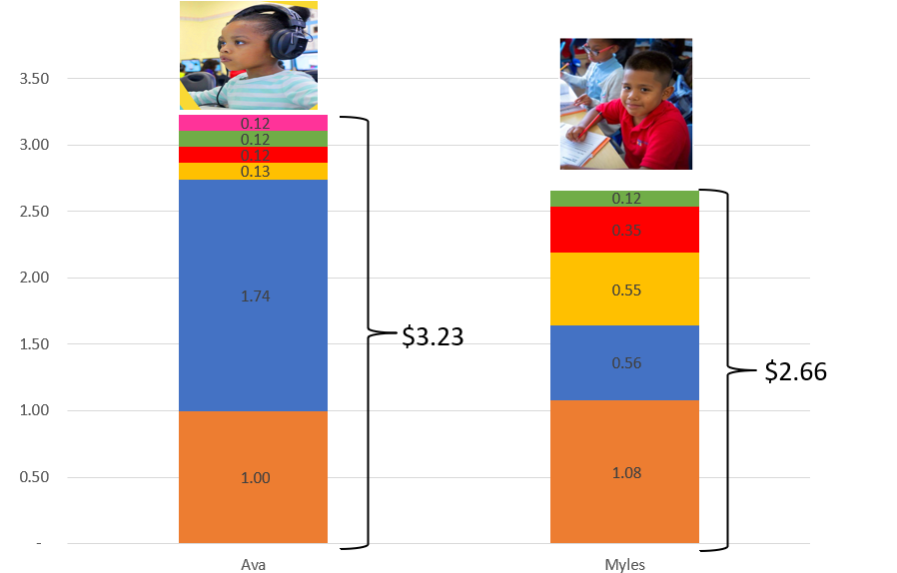
How the FSF Weights Work Per Student: If the Per Capita Were $1
12

Slide 13
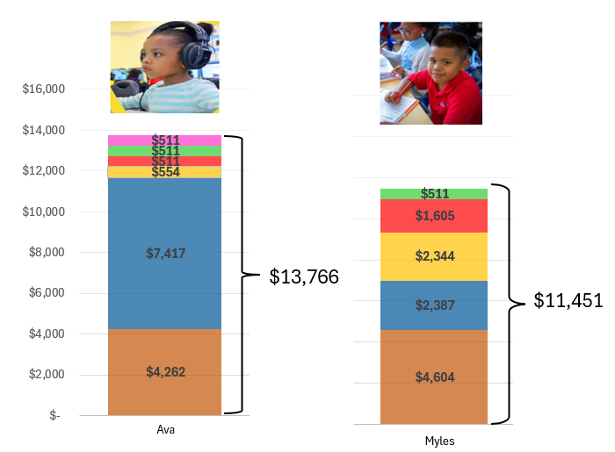
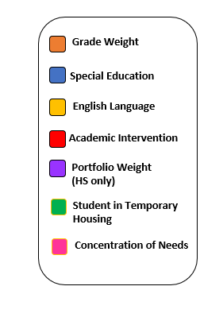
How the FSF Weights Work per student: At the 2025-2026 per capita of $4,262
13

Slide 14
Budget Webpages
You can find an overview of the NYCPS’ budget on the NYCPS’ website, under “About Us >> Funding Our Schools”
https://www.schools.nyc.gov/about-us/funding/funding-our-schools
You can find the following online on the NYCPS’ “Infohub,” under “Reports >> Financial Data and Reports”:
Detailed information about each and every school budget allocation in the form of “school allocation memoranda” or “SAMs.”
A programmatic guide to Fair Student Funding, as well as how the FSF allocation is calculated for each school [New Look].
You can find the following online on each individual school webpage, under “Reports >> Budget and Finances”: (see directions on slide 15)
Detailed information of the school’s budget based on the different types of funding schools receive, and
Detailed information as to how the Principal has budgeted for the current year, including the number of staff positions and other planned spending.

Slide 15
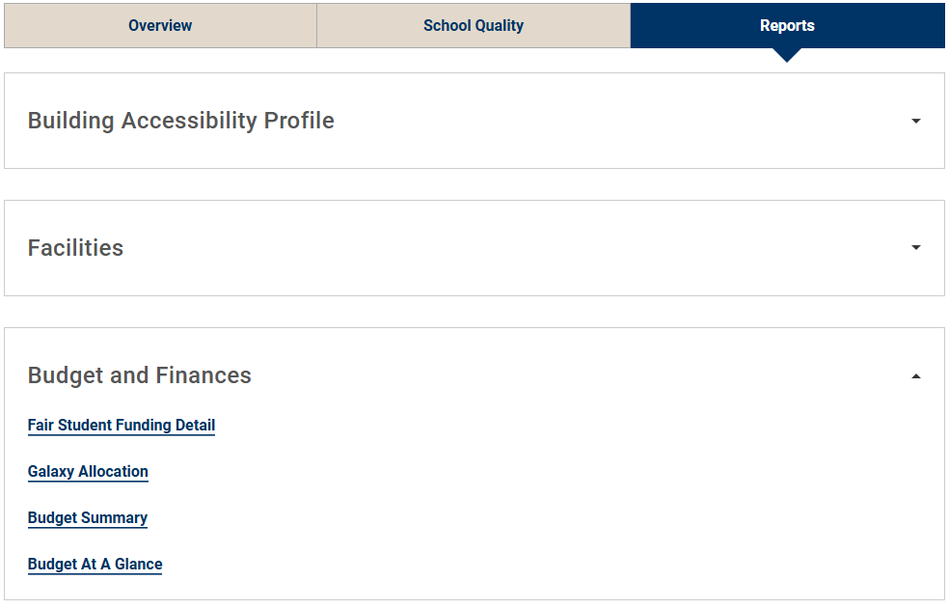
Where can I find information about my school’s budget?
Step 1: Choose a school
Step 2: Select the Reports Tab
Step 3: Open “Budget and Finances”
Step 4: Review reports
Fair Student Funding Detail: Fair Student Funding allocation and associated student counts. New Streamlined Look.
Galaxy Allocation: Current budget by source of funding
Budget Summary: Current budget by use of funding
Budget At a Glance: [NEW] High level summary of school level budget allocations, spending plan, and school demographics compared to citywide averages.

Slide 16
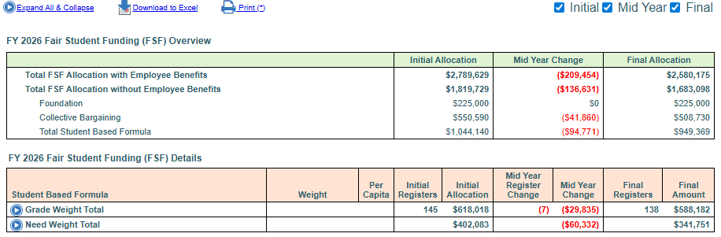
Fair Student Funding Details Web Page by School
Shows enrollment and dollars
Beginning of the School Year “Initial Allocation” (based on projected registers).
The Mid-Year Change (based on actual registers).
The Final Allocation (based on actual registers).
Register Change
Final Registers
Projected
This school was projected to have 145 students. They fell short of enrollment projections by 7 students and the projections for student needs. The school received funding for the 138 students enrolled.
Expand to see details by FSF Category and Weight.

Slide 17
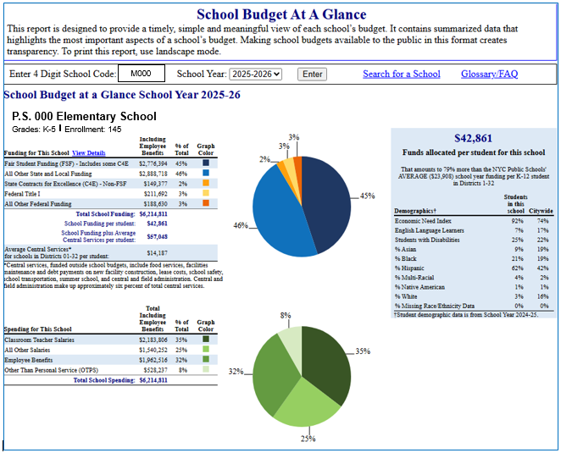
The School Budget at a Glance Report A One Pager Showing:
Total Budget per Capita
School Funding
School Spending
Student Demographics
All in simplified terms, with comparable data across schools.
17

Slide 18
We Welcome Your Feedback Your voice matters to us.
Comments and questions may be directed below between March 9, 2026 and April 28, 2026.
Via email to
BudgetPublicComments@schools.nyc.gov
– OR –
By phone to (212) 374-6754.

Slide 19
Thank you!

